Slide 1
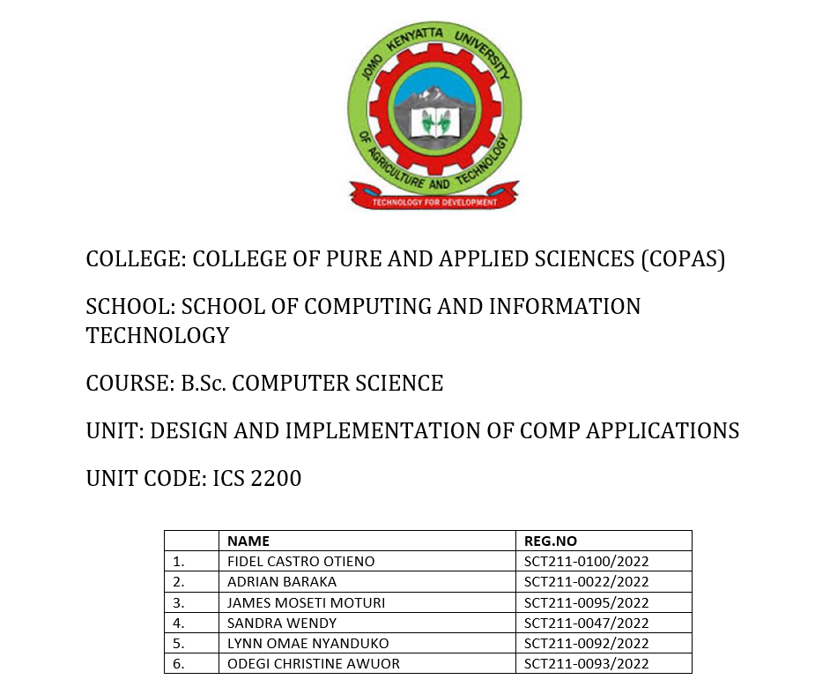

Slide 2
Restaurant Management System(RMS)
UI/UX Designs

Slide 3
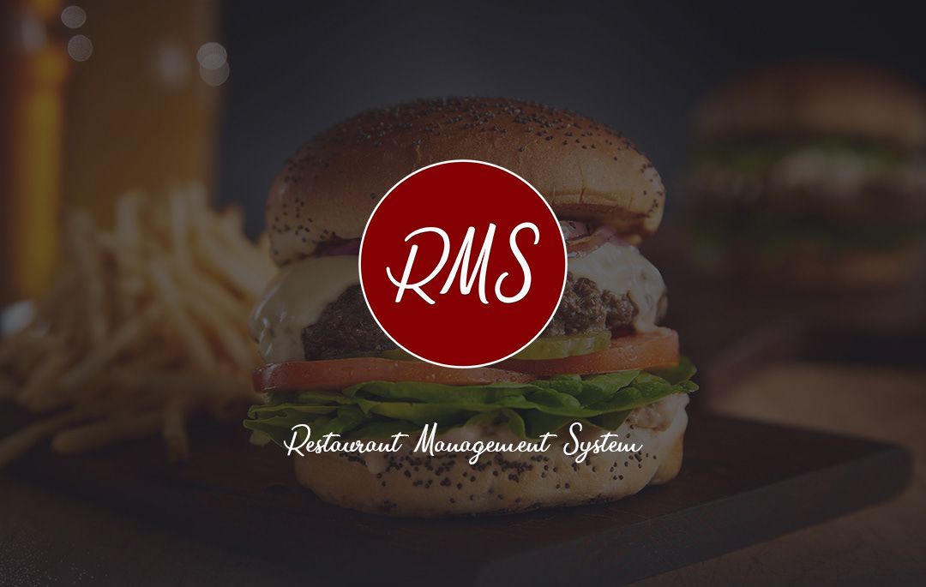

Slide 4
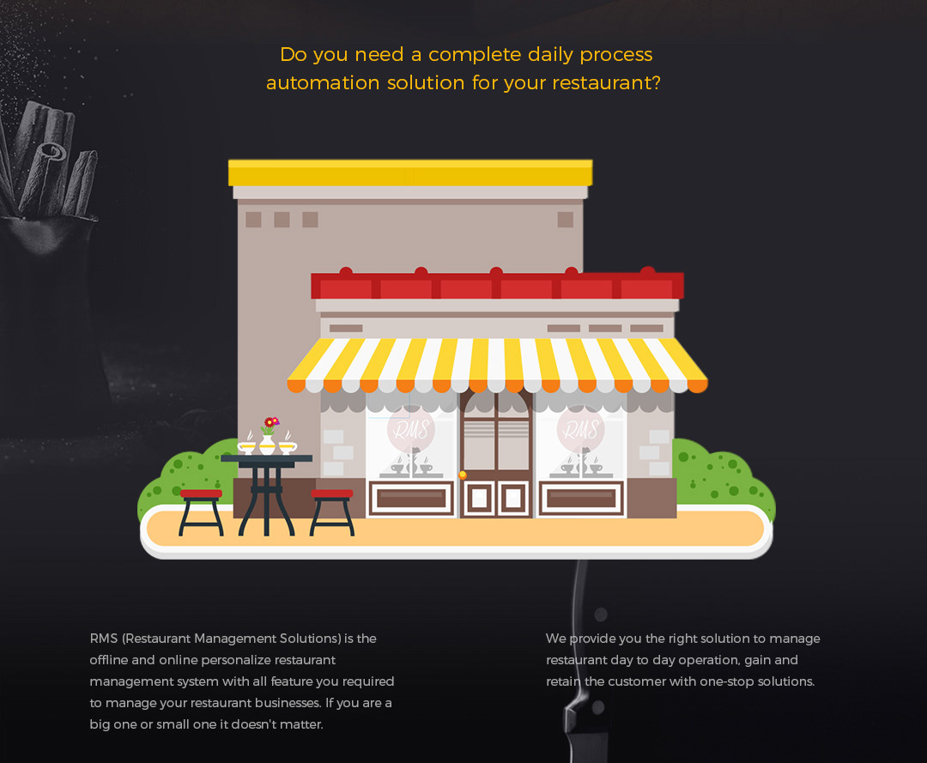

Slide 5
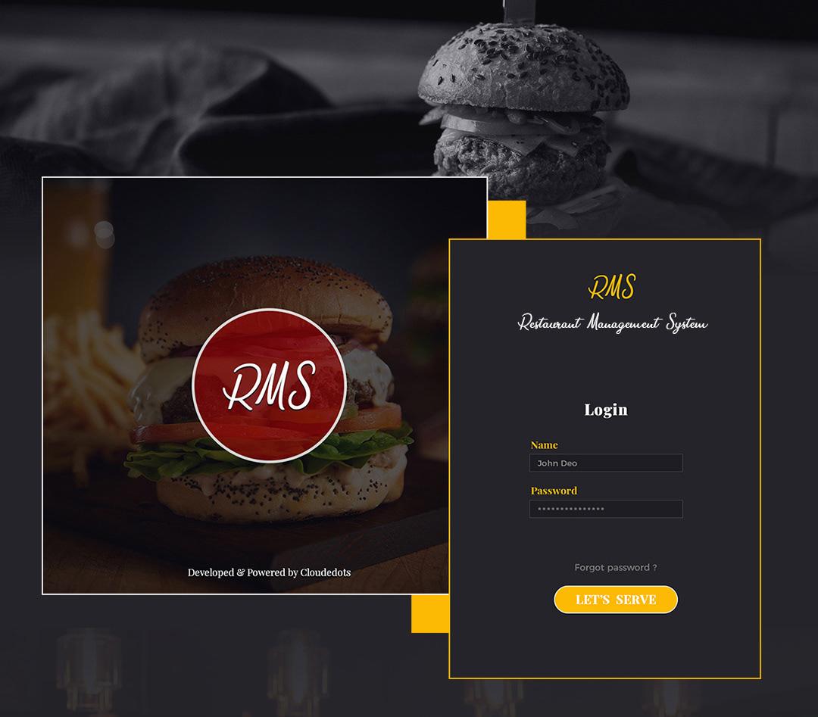

Slide 6
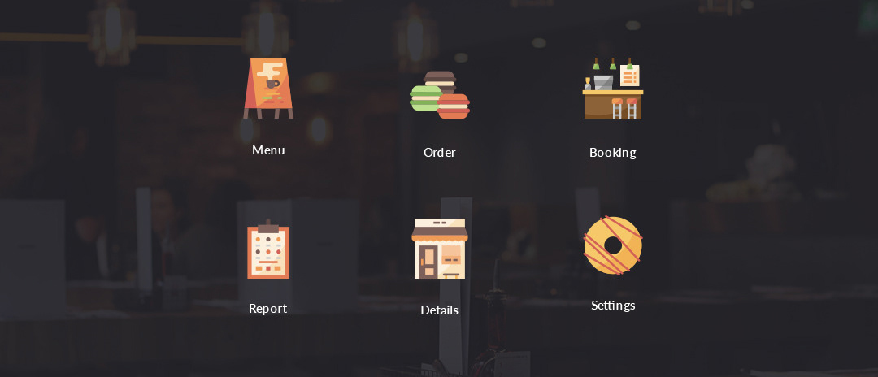

Slide 7
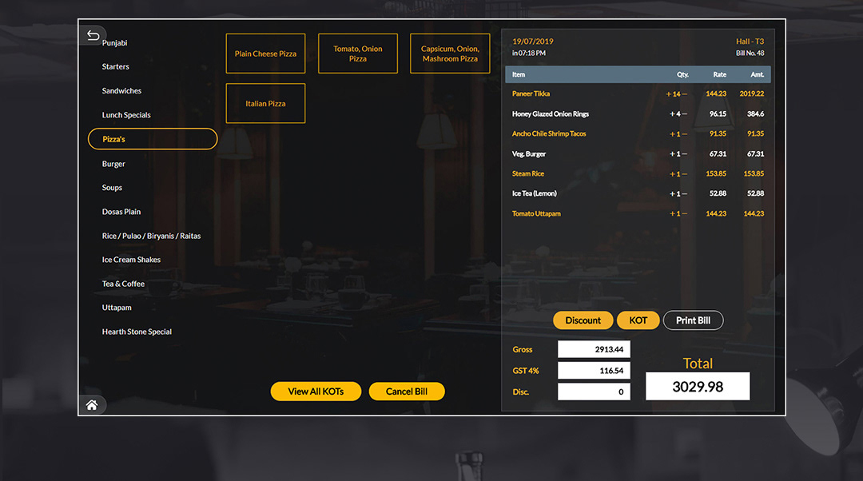

Slide 8
A restaurant and food delivery application
In the long run restaurants have become very busy and tiresome to run with the old traditional way of a waiter having to wait for you to decide what to eat and writing it down to the later take it to the kitchen for your food to be served.
In most cases they normally end up mixing the orders or even taking the right order but to the wrong table.
With most people increasingly living in the urban areas the equally find it better and more economical to have food that is pre made than having to make it themselves.

Slide 9
How will it be operating?
The system will display an intuitive menu for making orders.
The system will have an option for reservation, making deliveries.
The system will be integrated to a point of sale terminal and an inventory management.
It will also have a feedback mechanism.

Slide 10
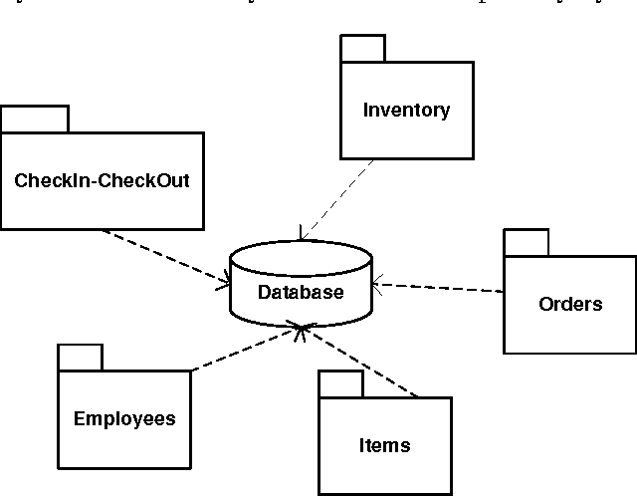
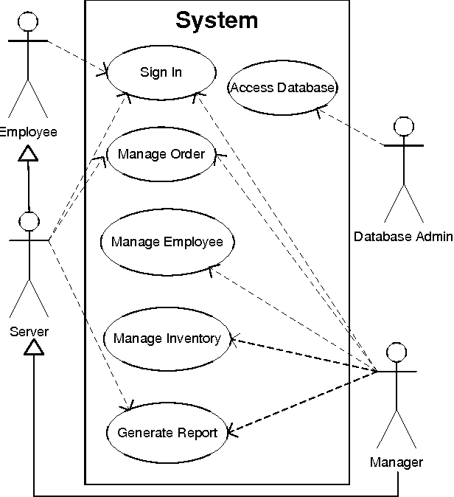
What will be the System Architecture?

Slide 11
The system architecture is the conceptual model that defines the structure, behavior and more views of the system.
Our system will incorporate the System Architecture(s) depicted in slide (7) in the delivery of services to ensure the smooth running of operations

Slide 12
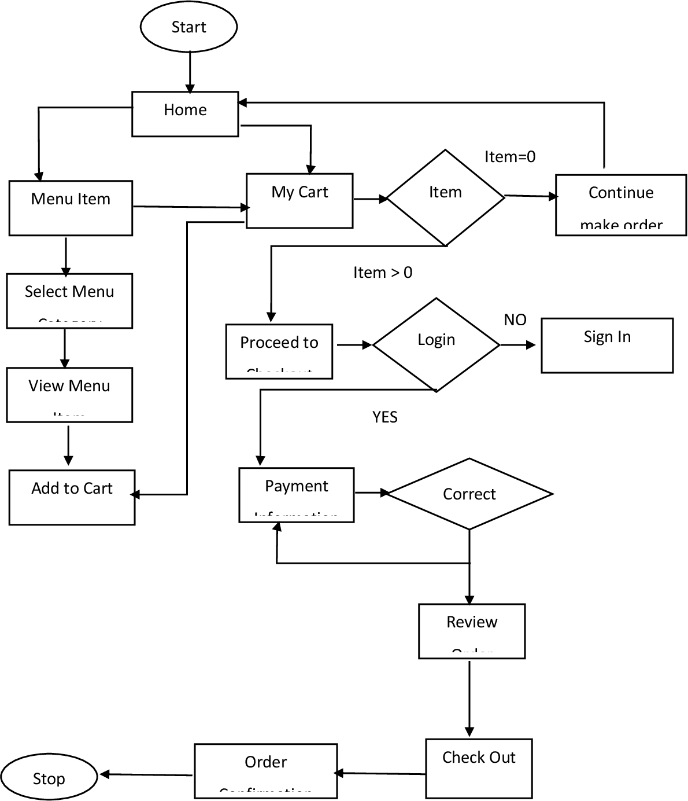
A FLOWCHART THAT REPRESENTS MAIN ACTIVITIES OF THE SYSTEM

Slide 13
Functional Requirements of the Restaurant Management System 1.User Authentication:
The modern restaurant management system will have secure user authentication mechanisms, including login and logout functionality.
Different user roles such as admin, manager, waiter, and chef will be defined with corresponding access levels.

Slide 14
2.Menu Management:
The system will be able to:
Create, update, and delete menu items.
Categorize of menu items (appetizers, main course, desserts, etc.).
Specify prices, ingredients, and descriptions for each menu item.
Support for adding images to menu items.

Slide 15
3.Order Processing:
Staff will be able to create new orders for customers.
Through the system staff will be able to modify orders, add or remove items, and handle special requests.
The system will be integrated with kitchen display system to notify chefs about new orders.
The system will offer support for order status tracking (e.g., ordered, in preparation, served).

Slide 16
4.Table Management:
Through the system staff will be able to:
Assign and manage tables for customers.
Track table occupancy status (occupied, available, reserved).
Transfer orders between tables if needed.
Integrate with the billing system to associate orders with tables.

Slide 17
5.Billing and Payment:
The system will be able to:
Generate accurate bills based on ordered items and applicable taxes.
Support for multiple payment methods (cash, credit card, mobile payments).
Print or email receipts to customers.
Split bills among multiple customers.

Slide 18
6.Inventory Management:
The system will be able to:
Keep track of ingredient stock levels.
Automatically deduct ingredients used in preparing dishes.
Set up alerts for low stock levels and order restocking when necessary.

Slide 19
7. Management:
The restaurant management system will be able to:
Maintain employee records, including personal details and job roles.
Track employee work hours and performance.
Allow managers to assign tasks and responsibilities to staff.

Slide 20
8.Reporting and Analytics:
The modern restaurant management system will:
Generate reports on sales, revenue, and popular menu items.
Have analytical tools for decision-making based on data insights.
Have historical data tracking for trends and forecasting.

Slide 21
Customer Relationship Management (CRM):
The restaurant management system will be able to:
Capture and store customer information for loyalty programs.
Record customer preferences and special requests.
Implement feedback mechanisms for customers to provide reviews.

Slide 22
Integration with External Systems:
The system will have functionality for:
Interface with accounting software for financial records.
Integration with online ordering platforms.
Connection with reservation systems for managing bookings.

Slide 23
HARDWARE REQUIREMENTS
Processor: Intel Core i3 or better (for optimal performance and multitasking)
RAM: Minimum 4GB RAM (8GB+ recommended for handling multiple operations)
Storage: 128GB SSD or more (SSDs are significantly faster than traditional hard disk drives)

Slide 24
SOFTWARE REQUIREMENTS
Operating System: Windows 7, Windows 8/8.1, Windows 10, Windows 11 (Visual Basic .NET applications work best on the Windows OS)
Development Environment: Visual Studio (Community, Professional, or Enterprise edition). Microsoft Visual Studio is the go-to development environment for Visual Basic projects.
.NET Framework: The appropriate version of the .NET Framework that your Visual Basic project targets.
DBMS: An appropriate database management system for managing data such as MySQL, Microsoft Access, Oracle.

